Slide 1
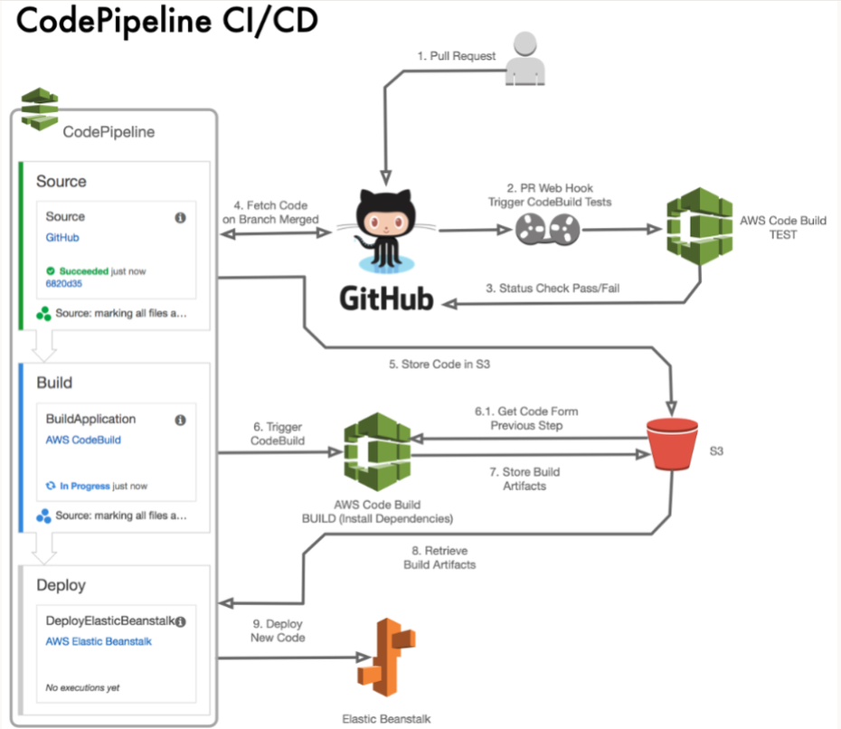
AWS developer Capstone project – Ci / CD Pipeline
By Aayush Singh

Slide 2
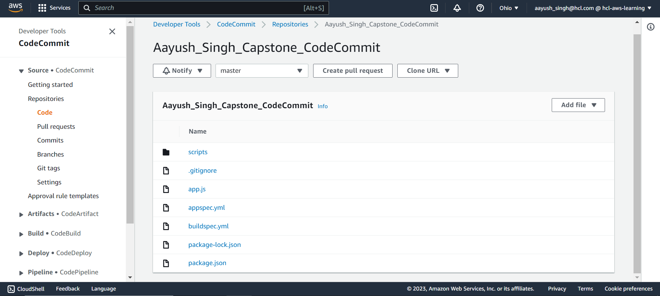
Code Commit Repository
Created Code Commit Repository and pushed all the
Node Express demo application code files using git

Slide 3
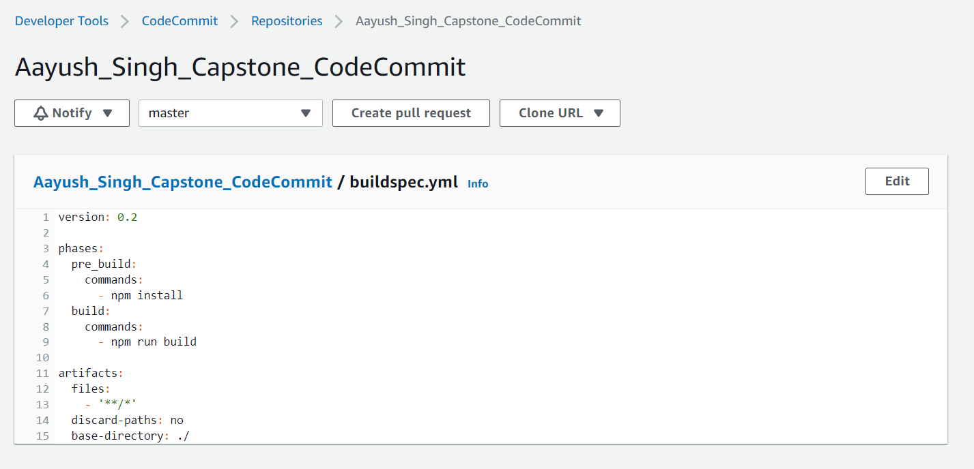
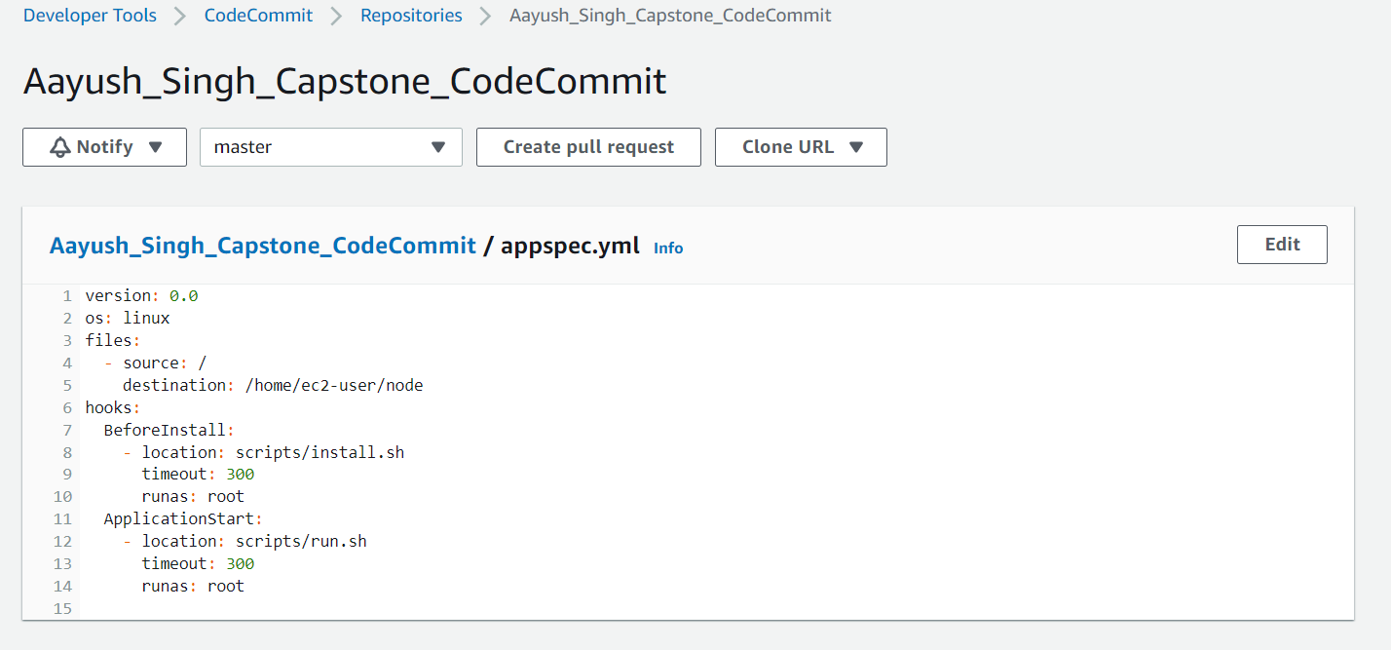
Code Commit BuildSpec.YML & APPSPEC.YML
Installing dependencies and then building the application
Code for production servers
Install script to install dependencies and
Run script to run the application with express

Slide 4
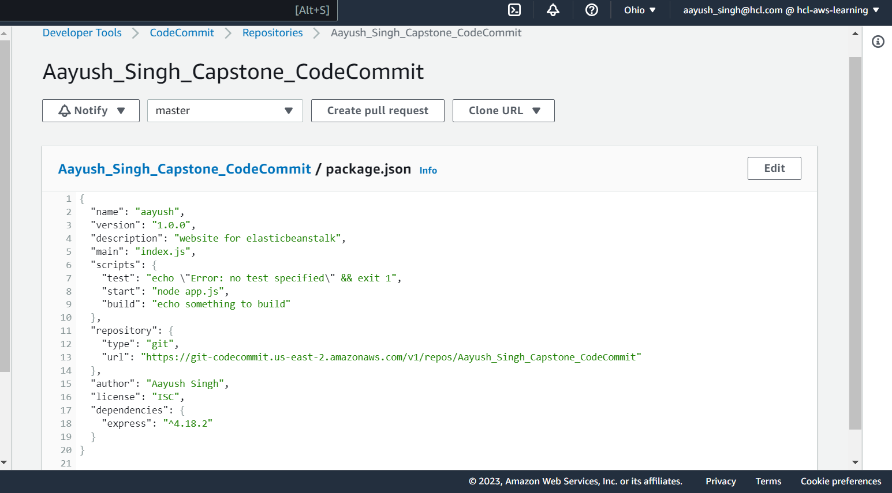
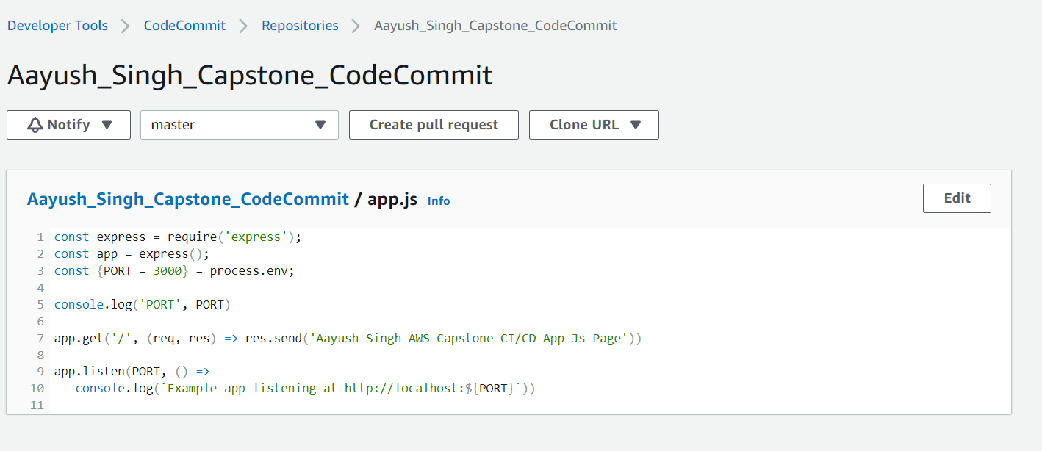
Code Commit App.JS & Package.json
Sending a custom message response to the
Browser after express app is running on port 3000

Slide 5
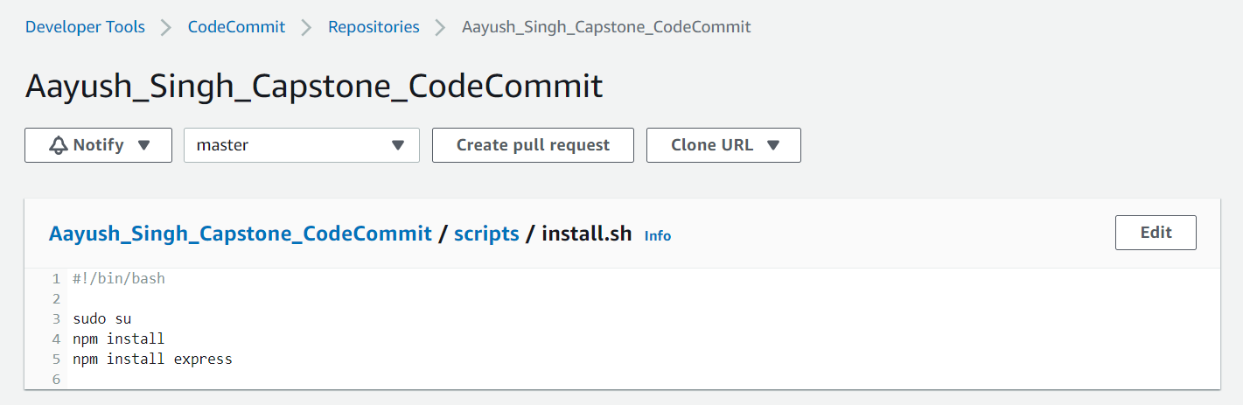
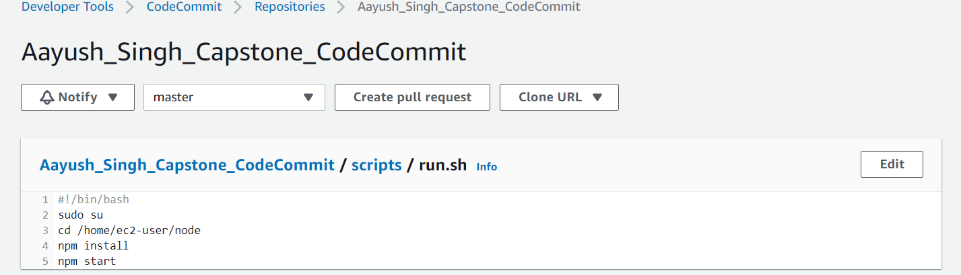
Code Commit Install.sh & Run.sh
To install express and other dependencies in node modules
Starting the application to server the app.js page in the browser

Slide 6
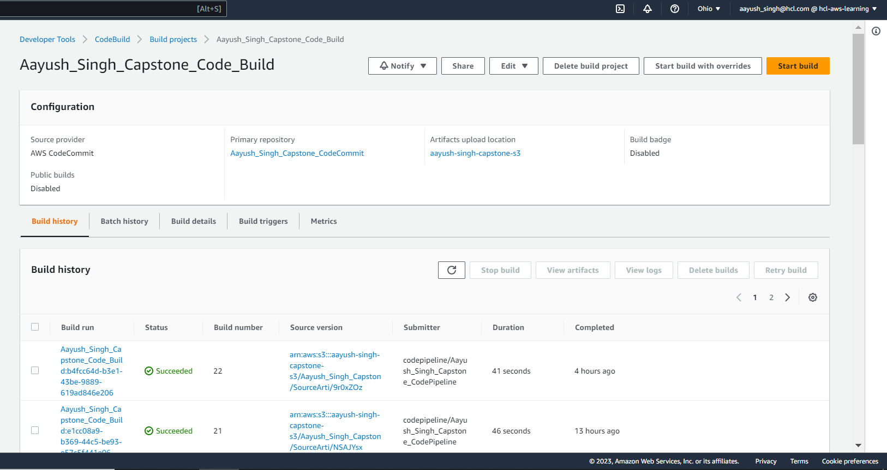
Code Build - 1

Slide 7
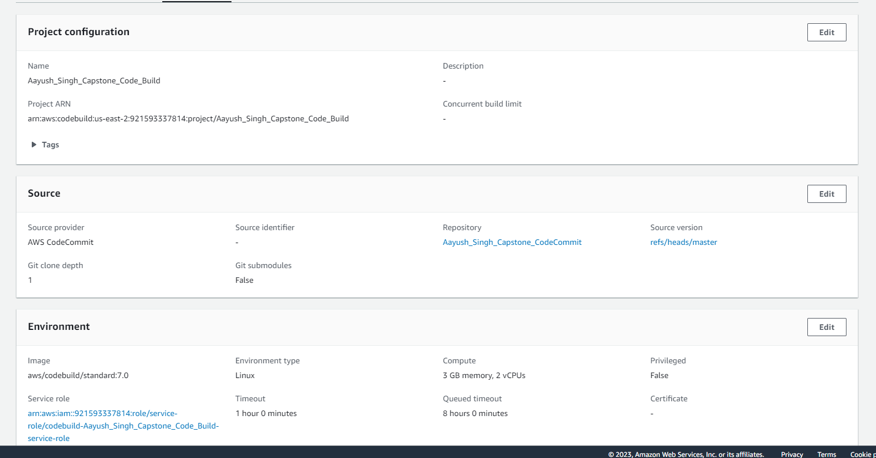
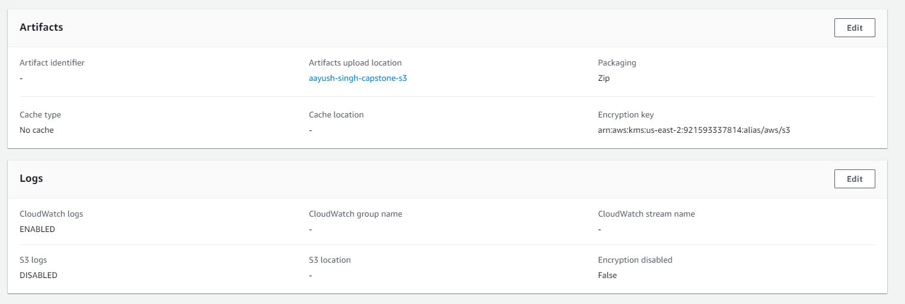
Code Build - 2

Slide 8
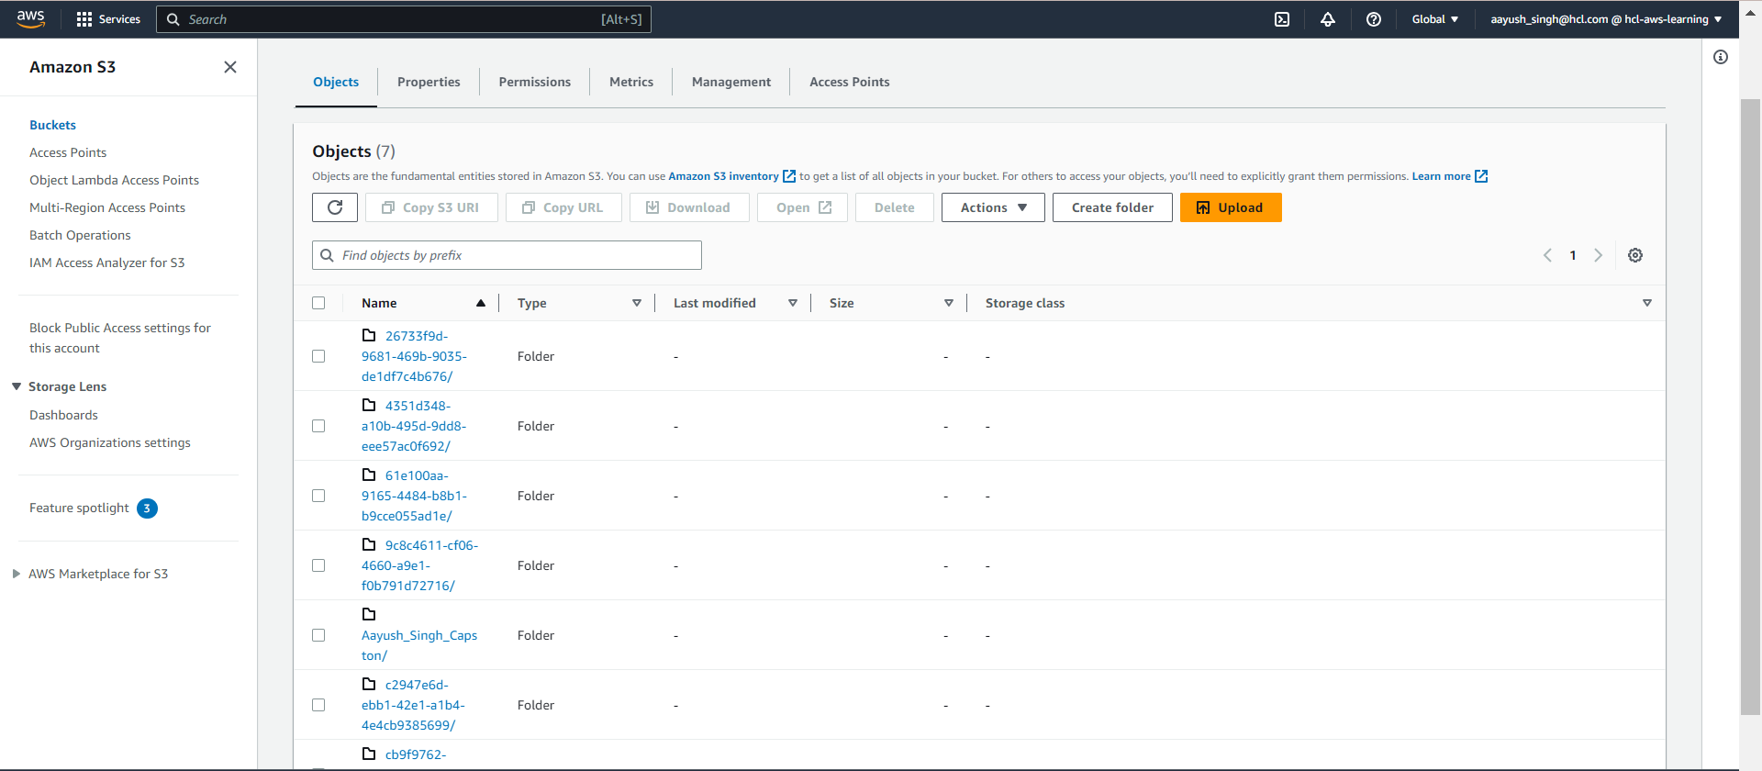
S3 Bucket for artifacts

Slide 9
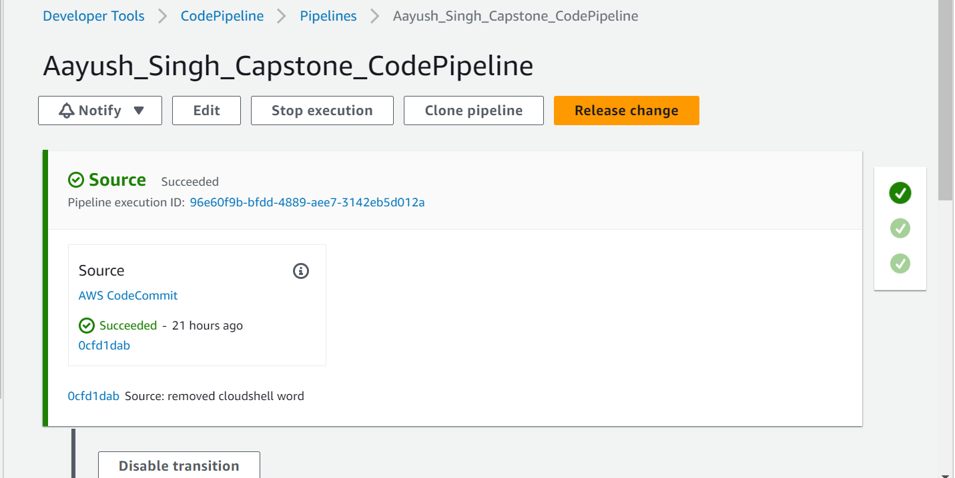
Code Pipeline - 1

Slide 10
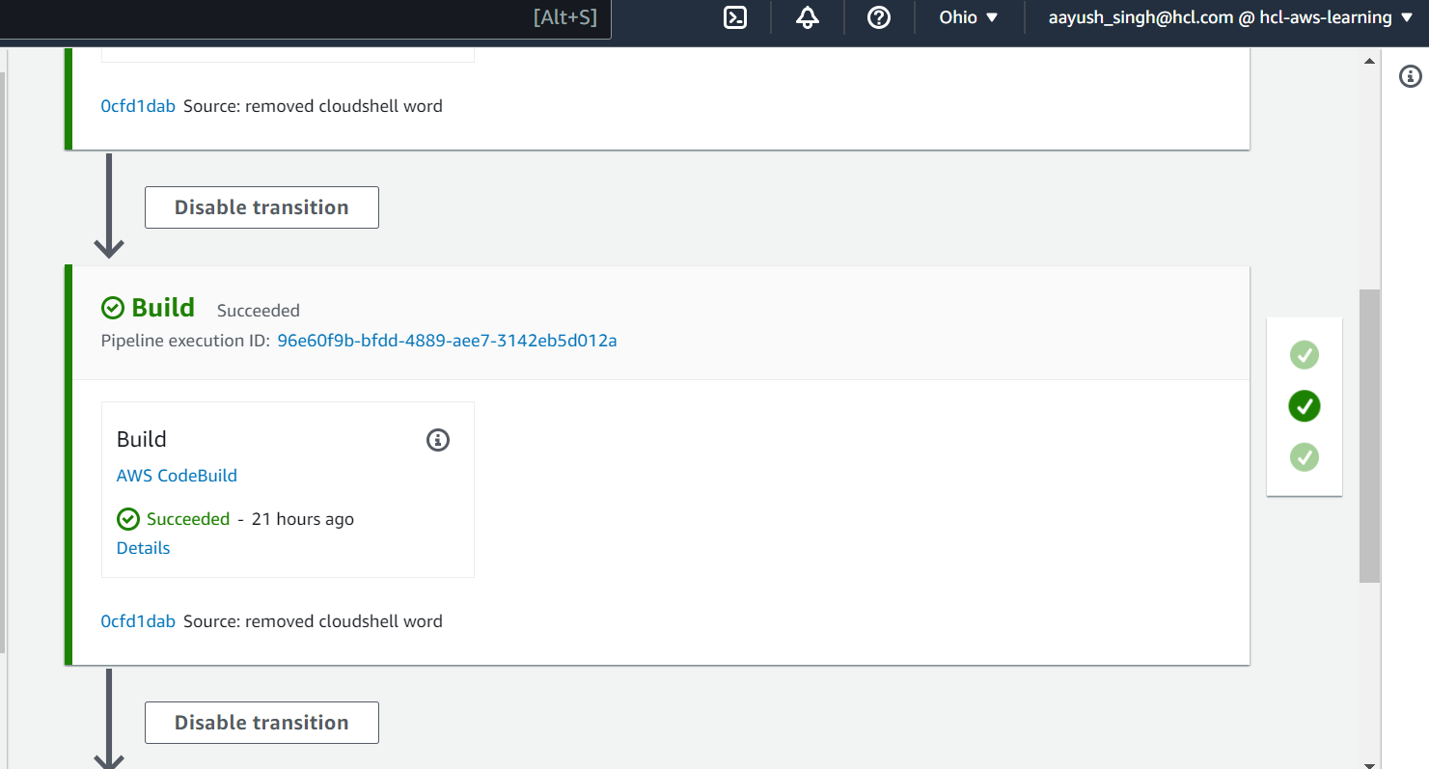
Code Pipeline - 2

Slide 11
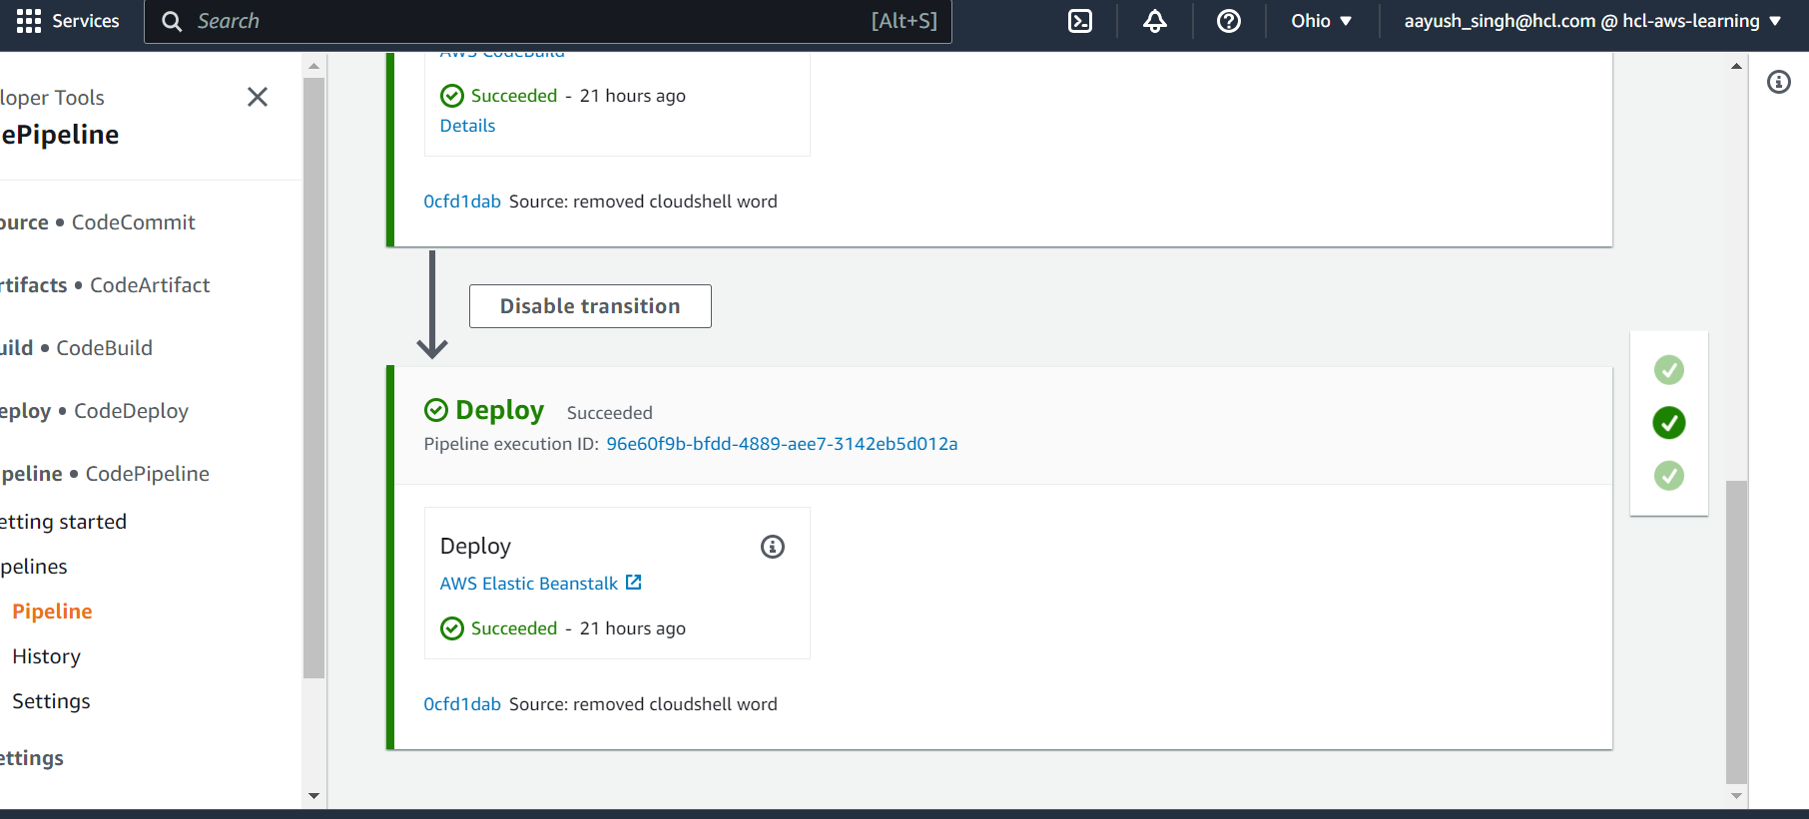
Code Pipeline - 3

Slide 12
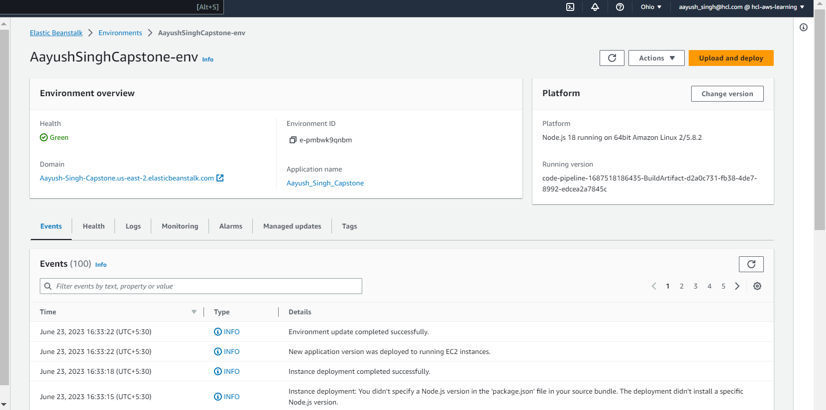
Elastic Beanstalk

Slide 13
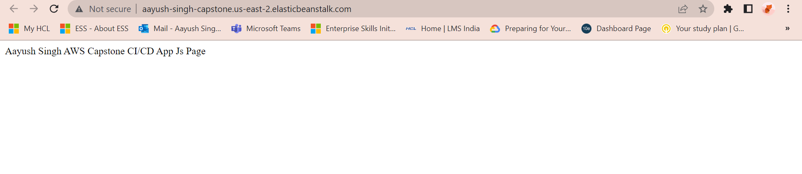
Elastic Beanstalk URL Result

Slide 14
THANK YOU
Aayush Singh
Software Engineer (HCLTech)
aayushsinghx0709@gmail.com

